Slide 1
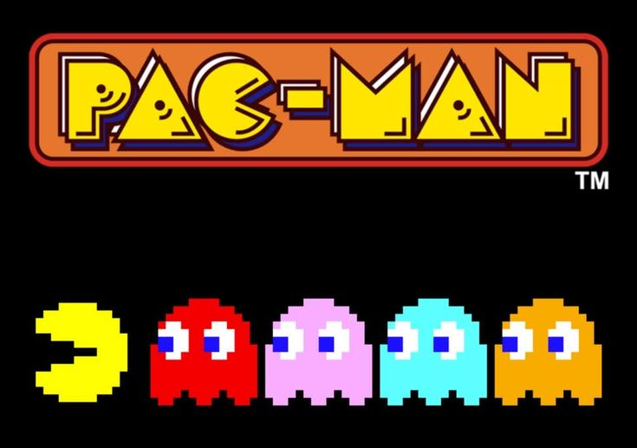
Pacman clone using greedy algorithms
Demonstrating AI-Driven Ghost Behaviors

Slide 2
Introduction
Overview :
This project is a clone of the classic Pacman game.
The main objective was to understand game development and AI algorithms by recreating Pacman with modern tools.
Historical Context :
Pacman was created by Toru Iwatani and released by Namco in 1980.
It became an iconic game known for its simple yet addictive gameplay and pioneering AI-driven enemy behaviors.

Slide 3
Reason for Creating the Clone
Educational Purpose:
To explore and understand game development techniques.
To implement and study artificial intelligence (AI) algorithms in a real-time interactive environment.
Classic Game Tribute :
To recreate a beloved classic using modern programming tools and methodologies.
Skill Development :
Enhance proficiency in C++ and the SFML library.

Slide 4
Summary of How the Game Works
Objective :
Navigate Pacman through a maze to consume all pellets while avoiding ghosts.
Player Control :
Pacman is controlled using arrow keys for movement in four directions.
Game Entities :
Pacman: The player-controlled character that moves through the maze.
Ghosts: Four enemy entities (red, pink, blue, and orange) with unique targeting behaviors.
Pellets and Energizers: Items Pacman consumes to score points and gain temporary invincibility.

Slide 5
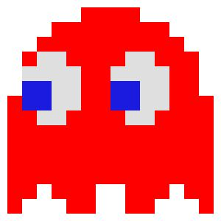

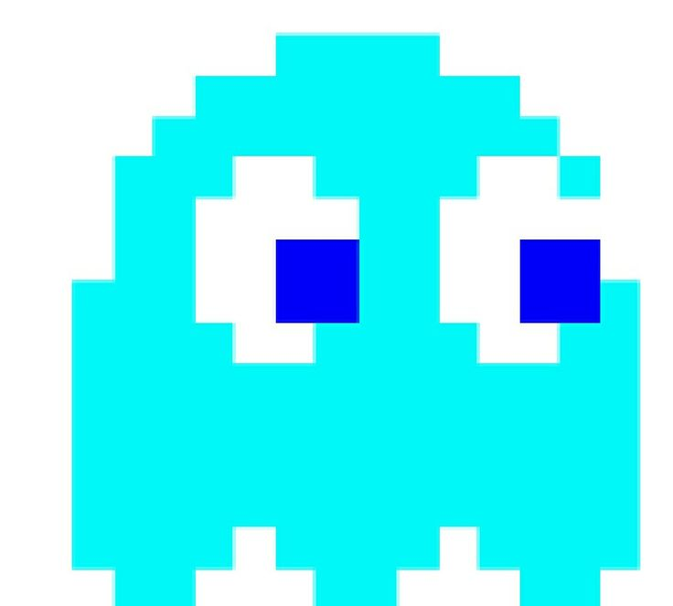
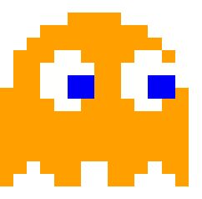
Ghost Behaviors
Red Ghost :
Directly targets Pacman's current position.
Pink Ghost :
Targets four tiles ahead of Pacman's current direction.
Blue Ghost :
Uses a combination of Pacman's position and the red ghost's position for targeting.
Orange Ghost :
Alternates between targeting Pacman and retreating to a corner based on proximity.

Slide 6
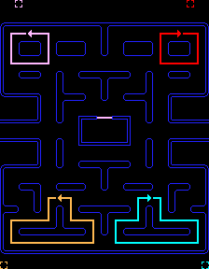
Game Modes
Scatter Mode :
Ghosts target specific corners of the maze.
Chase Mode :
Ghosts pursue Pacman using their unique targeting strategies.
Frightened Mode :
Activated when Pacman consumes an energizer, making ghosts vulnerable and move away from Pacman.

Slide 7
Technical Implementation
Programming Language: C++
Graphics Library : SFML (Simple and Fast Multimedia Library)
AI Algorithms :
Greedy pathfinding for optimal ghost movements.
Collision detection using circle-based calculations.
Game Mechanics :
Responsive controls for Pacman.
Dynamic animations using sprite sheets.

Slide 8
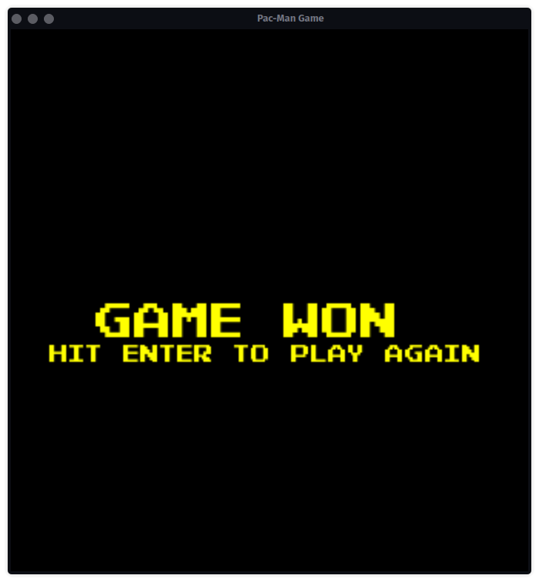
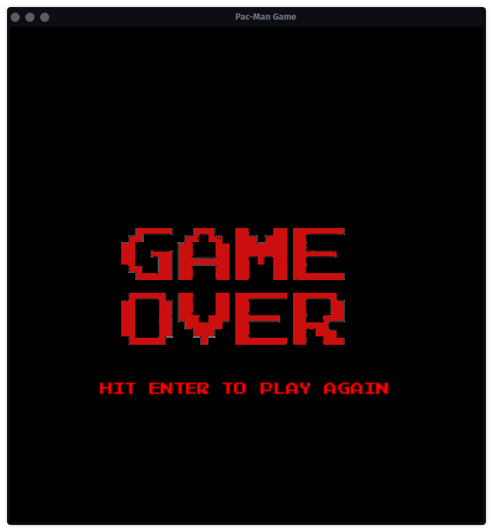
Demo Samples
Main gameplay screen

